Slide 1
The Thomson Problem and Convex Polyhedra

Slide 2
What is the Thomson Problem?
Originated by the physicist J.J.Thomson in 1904
Based from the idea of the Plum Pudding atomic model
To determine the minimum energy configuration of N electrons distributed on the surface of the unit sphere

Slide 3
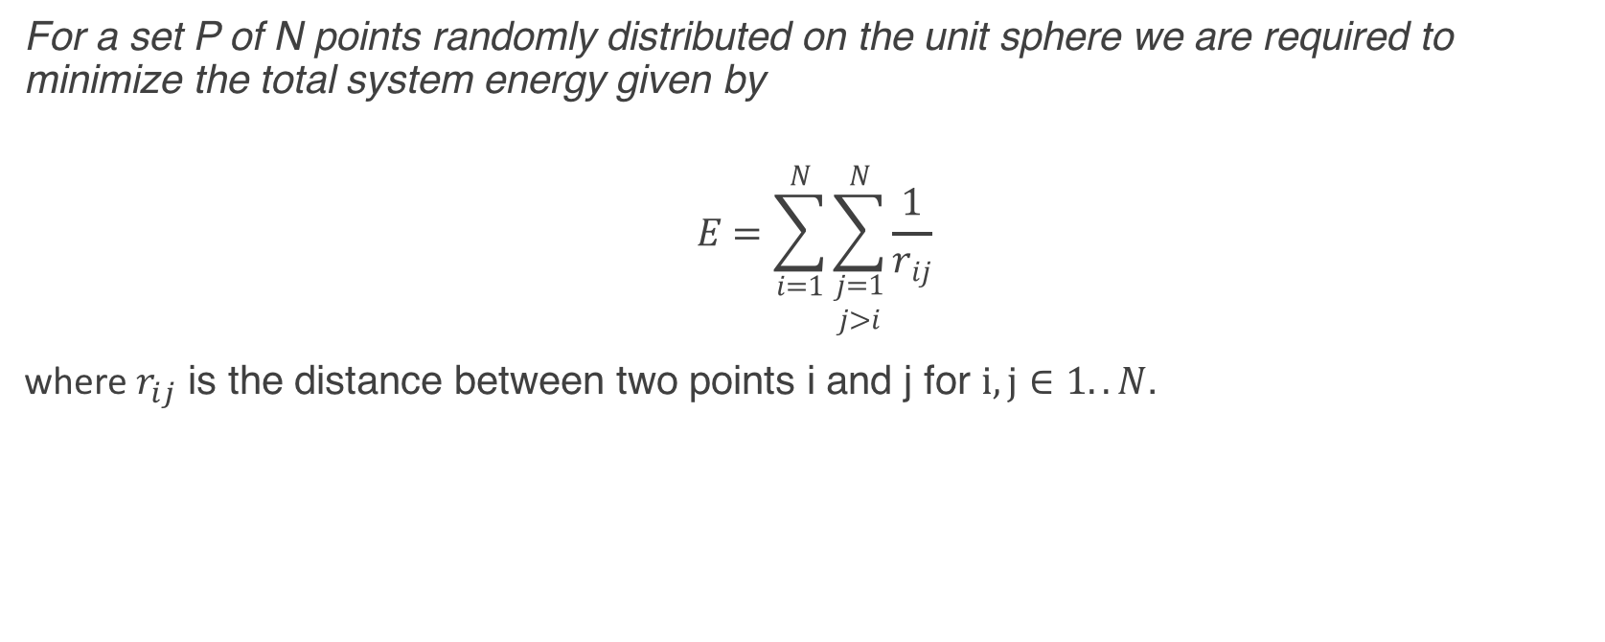
What is the Thomson Problem?
For a set P of N points randomly distributed on the unit sphere we are required to minimize the total system energy given by
$$E=\sum_{i=1}^{N}{\sum_{\begin{aligned}j=1 \\ j>i\end{aligned}}^{N}{\frac{1}{r_{ij}}}}$$
where $r_{ij}$ is the distance between two points i and j for $i,j∈1..N$.

Slide 4
Monte Carlo Methods and the Metropolis Algorithm
Monte Carlo methods involve generating suitable random numbers in order to obtain numerical results for problems too complex or difficult to solve using analytic methods. The Metropolis algorithm is one such method where we introduce an accept/reject step determined by the Boltzmann probability of a move.
The Metropolis algorithm requires a symmetric jump distribution which is why the Gaussian and uniform distributions are commonly used.

Slide 5
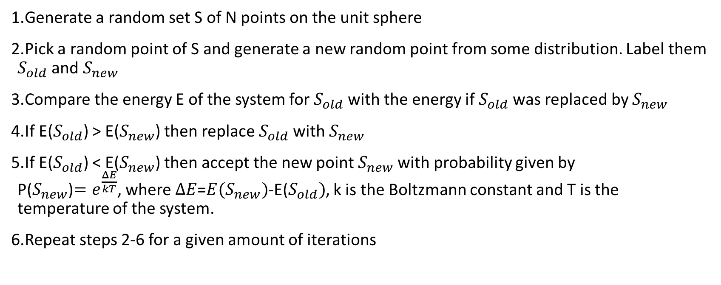
The Applied Metropolis Algorithm
Generate a random set S of N points on the unit sphere
Pick a random point of S and generate a new random point from some distribution. Label them $S_{old}$ and $S_{new}$
Compare the energy E of the system for $S_{old}$ with the energy if $S_{old}$ was replaced by $S_{new}$
If E($S_{old}$) > E($S_{new}$) then replace $S_{old}$ with $S_{new}$
If E($S_{old}$) < E($S_{new}$) then accept the new point $S_{new}$ with probability given by P($S_{new}$)${=e}^{\frac{ΔE}{kT}}$, where $ΔE$=${E(S}_{new})$-E($S_{old})$, k is the Boltzmann constant and T is the temperature of the system.
Repeat steps 2-6 for a given amount of iterations

Slide 6




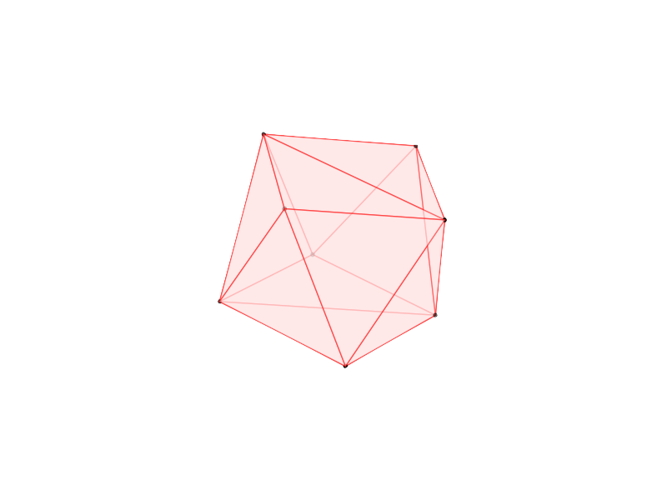
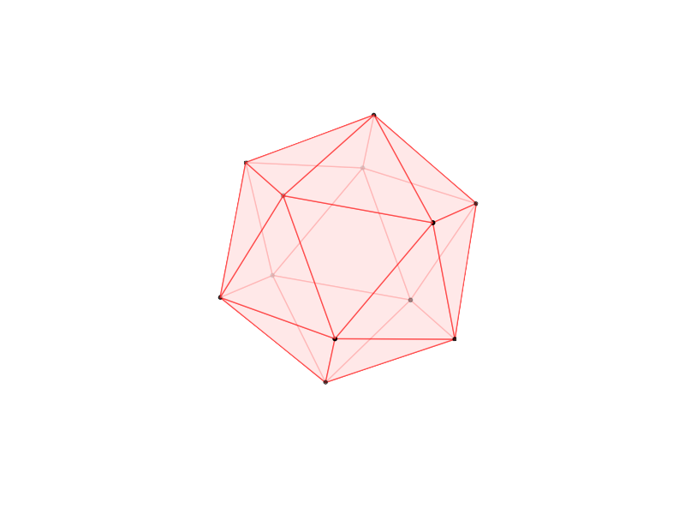
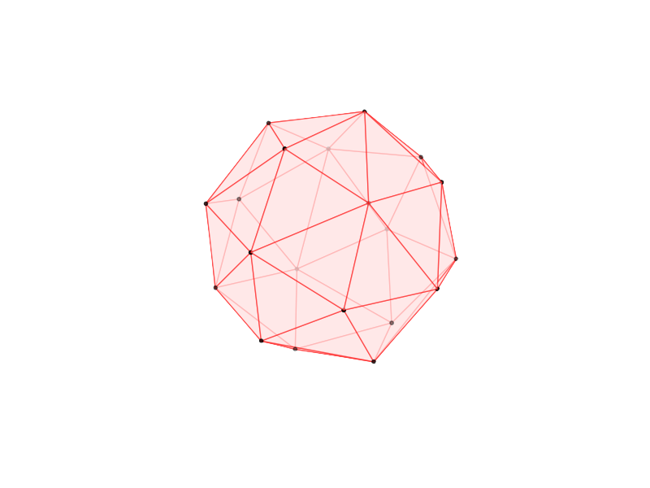
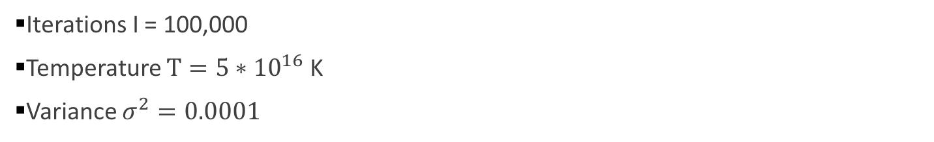
Output Examples
Iterations I = 100,000
Temperature $T=5∗{10}^{16}$ K
Variance $σ^{2}=0.0001$
N=4 E =3.674235
N=6 E=9.985288
N=8 E=19.675290
N=12 E=49.165261
N=20 E=150.883740

Slide 7
Comparison to Currently Known Minima
N | Our Energy Result | Current Energy Minima | Difference
4 | 3.674235 | 3.674234614 | 0.000000386
6 | 9.985288 | 9.985281374 | 0.000006626
8 | 19.675290 | 19.675287861 | 0.000002139
12 | 49.165261 | 49.165253058 | 0.000007942
20 | 150.883740 | 150.881568334 | 0.002171666
Courtesy of https://en.wikipedia.org/wiki/Thomson_problem

Slide 8
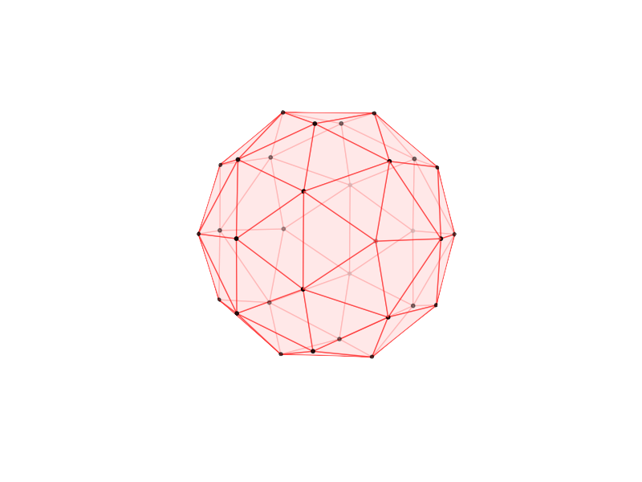
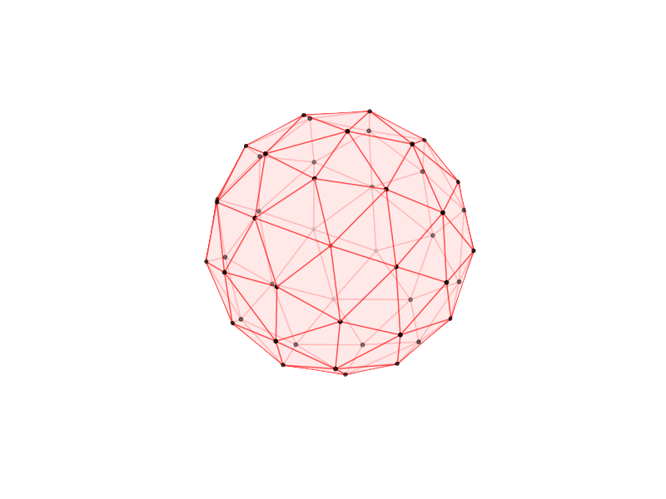
Large systems and General Trends
Hexagonal and pentagonal shapes occur frequently
Still tendencies towards equilateral triangles if possible
Small clusters of locally random configurations
Local minima

Slide 9
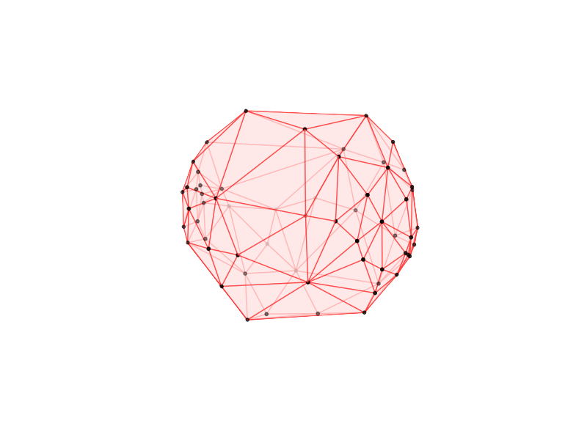
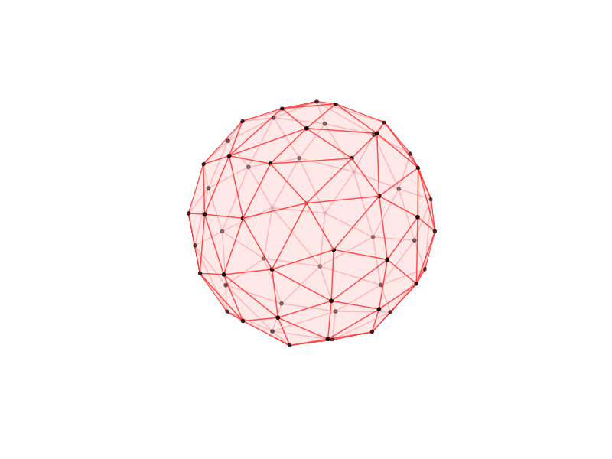
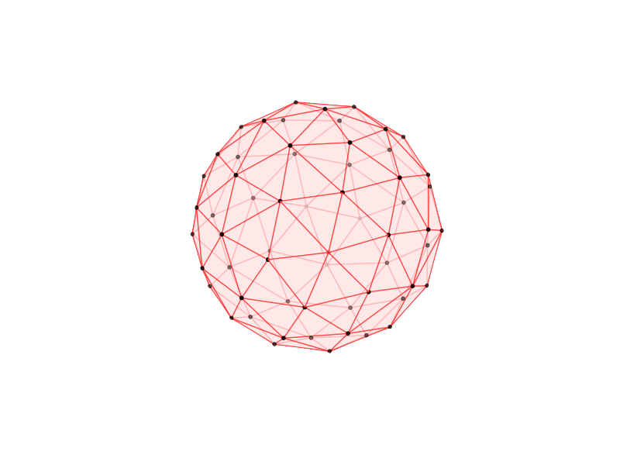
Small Improvements Example
I = 1000 E =1808.092155
I = 10000 E =1545.443486
I=1000000 E =1543.857140

Slide 10
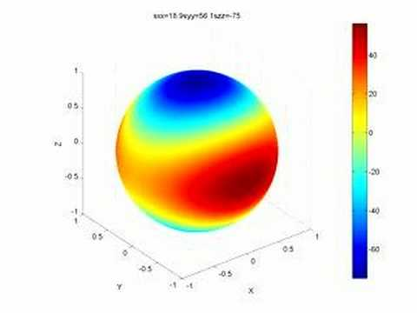
Ongoing Research
Currently looking at another algorithm, the Wang-Landau algorithm to calculate the density of states of a system
The Genetic algorithm will also be tested and implemented.

